Slide 1

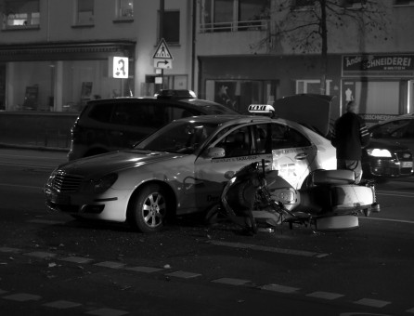
ROAD ACCIDENT ANALYSIS

Slide 2
ROAD ACCIDENT ANALYSIS
Submitted in the partial fulfillment for the award of the degree of
BACHELOR OF ENGINEERING
IN
CSE WITH SPECIALIZATIONS IN ARTIFICIAL INTELLIGENCE AND
MACHINE LEARNING
Submitted by:
DEKKA SRIDHAR(20BCS6174)
ISHIKA JAIN(20BCS6166)
AKHIL KUMAR(20BCS6116)
Under the Supervision of:
ARUN MITTAL

Slide 3

OUTLINE
Introduction
Problem Formulation
Objectives of the work
Methodology
Results and Outputs
Conclusion
Future Scope
References

Slide 4

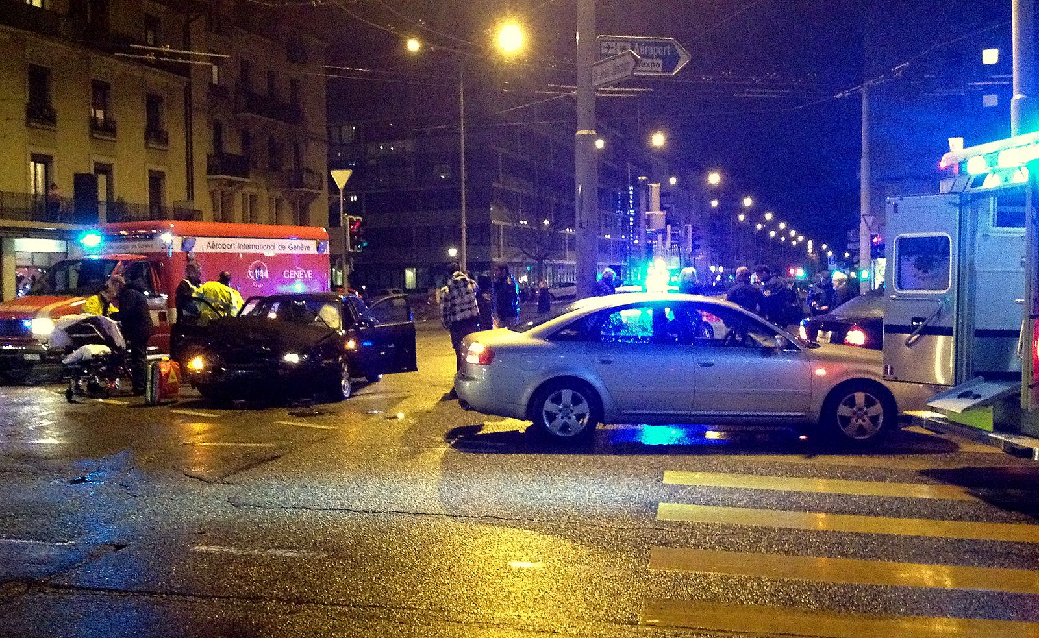
INTRODUCTION TO PROJECT
There is a huge impact on the society due to traffic accidents where there is a great costs of fatalities and injuries.
Approximately 1.35 million people die in road crashes each year; on average 3,700 people lose their lives every day on the roads.
An additional 20–50 million suffer non-fatal injuries, often resulting in long-term disabilities.
In recent years, there is a increase in the researches attention to determine the significantly affect the severity of the drivers injuries which is caused due to the road accidents. Accurate and comprehensive accident records are the basis of accident analysis. the effective use of accident records depends on some factors, like the accuracy of the data, record retention, and data analysis. There is many approaches applied to this scenario to study this problem.

Slide 5

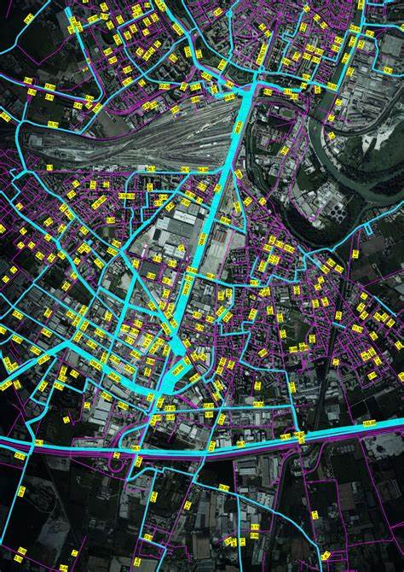
IMOPRTANCE OF ROAD ACCIDENT ANALYSIS
Road accidents are one of the most imperative factors that affect the untimely death among people and economic loss of public and private property. Road safety is a term associated with the planning and implementing certain strategy to overcome the road and traffic accidents. Road accident data analysis is a very important means to identify various factors associated with road accidents and can help in reducing the accident rate.
By using the previous data of all the road accidents occurred we can predict the severity of the accident which will help in decreasing the road accidents occurring.

Slide 6

PROBLEM FORMULATION
In recent years, vehicle accidents have emerged as a global issue and a leading cause of death worldwide. It has become a big issue because of massive vehicle accidents that occur every year. With the addition of information from this huge, calibrated data agglomerations have grown. The necessity for the cornerstone of machine learning has arisen.
Road safety is a serious problem as the number of automobiles on the road continues to rise. Globally, road crashes cost $518 billion, with different countries losing 1-2 percent of their GDP. In Hyderabad alone, there were 2367 accidents with injuries reported in 2017. To counteract this problem, steps have been taken, however they have proven ineffectual.
With increased resources, police can receive continuous predictions and alerts for each area at regular intervals, allowing them to take pre-emptive measures. The web app may be integrated with Google Maps, which the cops can track in real time. It can be used for Indian states or cities if the Indian government provides accurate accident data.

Slide 7


OBJECTIVES OF THE WORK
The major goal of the road accident prediction system is to analyze previously occurring accidents in the region, which will allow us to identify the most accident-prone areas and provide the rapid assistance that they demand. To produce forecasts based on factors such as weather, pollution, road structure, and so on.
The overall goal was to use mass accident data to disaggregate the road accident problem and identify groupings of road users, vehicles, and road segments that would be good targets for countermeasures to this process.
Machine Learning algorithms can analyze a huge number of categorization parameters and identifying relevant patterns. It could process large amounts of data quickly and is scalable. Artificial neural networks are computational models that are used in computer science and related fields.
Tons of accidents occur every day on every highway. So, what about creating a model that will help prevent accidents? We can prevent an accident by creating an accurate model with the help of the patterns of the accidents taking place in urban and rural areas. We can make a cluster of different patterns of accidents and can take necessary safety precautions based on that. But for that, we need an accurate record of road accidents that have taken place in the past few years. According to research, it is stated that residential areas are more prone to accidents. So, we can cluster the areas like that.

Slide 8





METHODOLOGY
ANACONDA:
Anaconda is a Python and R programming language distribution for scientific computing (data science, machine learning applications, large-scale data processing, predictive analytics, and so on), with the goal of making package administration and deployment easier.
VISUAL STUDIO CODE:
Visual Studio Code is a lightweight but capable supply code editor for Windows, macOS, and Linux that runs on your desktop. It has JavaScript, TypeScript, and Node built-in support.
PYTHON:
Python is an interpreted high-level programming language that may be used for a wide range of activities. Python features an automatic memory management system and a dynamic type of system.
It gives for a wide range of programming possibilities. There are 11 of them, including object-oriented, imperative, functional, and procedural paradigms. It also includes a substantial standard library.
SCIKIT-LEARN:
Scikit-learn is a Python-based machine learning library that is available for free. It includes support vector machines, random forests, gradient boosting, k-means, and DBSCAN, among other classification, regression, and clustering techniques, and is designed to work with the Python numerical and scientific libraries NumPy and SciPy.

Slide 9


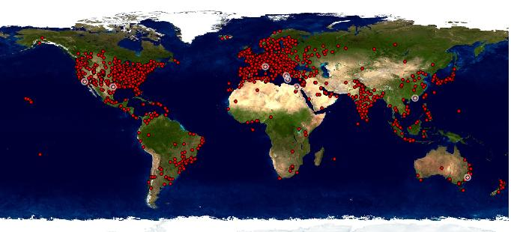

METHODOLOGY
NUMPY:
NumPy is the most important Python package for scientific computing. It includes a powerful N-dimensional array object as well as sophisticated (broadcasting) features. helpful linear algebra, Fourier transform, and random number capabilities tools for integrating C/C++ and Fortran code NumPy can be used as a multidimensional container of generic data in addition to its apparent scientific applications. It is possible to define any number of data kinds.
GOGGLE MAPS:
We can use Google Maps to discover a popular restaurant, calculate the shortest driving route and travel time, and so on. You're probably wondering how to accomplish it programmatically in Python if you've been provided a huge amount of location data to check and validate against a map and then select the optimal routes. We'll look at how to do all of these things with Python Google Maps APIs in this tutorial.
API:
Application Programming Interface (API) In basic terms, APIs just allow applications to communicate with one another and data to one another. The following APIs are used: The Geolocation API returns a location and accuracy radius based on data from cell towers and Wi-Fi nodes detected by the mobile client. This page explains the protocol 12 for sending data to the server and receiving a response from the server. POST is used to communicate over HTTPS. Both the request and the answer are in JSON format, with application/json as the content type. Open Weather Map's Weather API gives you access to current weather data, 5- and 16-day forecasts, UV Index, air pollution, and weather conditions, among other things. Text Local provides the SMS API.

Slide 10

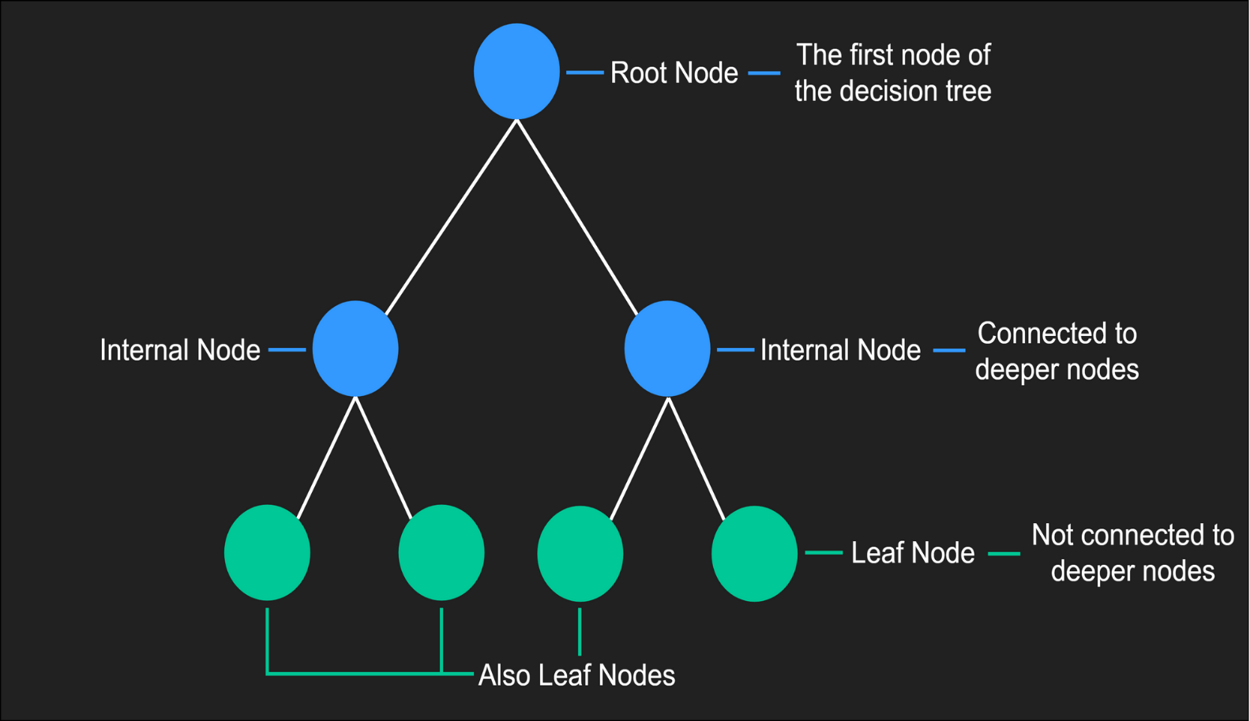
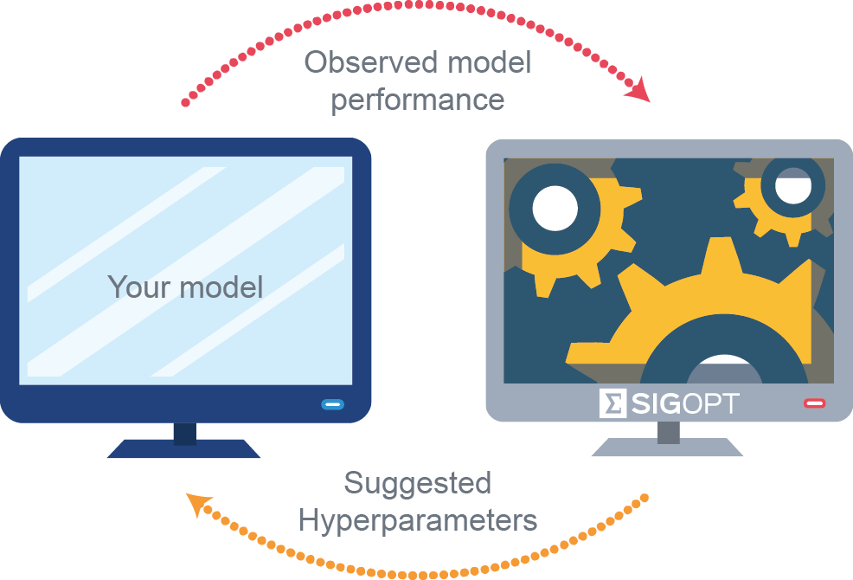
METHODOLOGY
ROAD ACCIDENT DECISION TREES AND RANDOM FORESTS:
A decision tree is a flowchart-like structure in which each internal node represents a "test" on an attribute (for example, whether a coin flip will come up heads or tails), each branch reflects the test's conclusion, and each leaf node represents a class label (decision taken after computing all attributes).
A fixed number of randomised decision trees are inducted to form an ensemble in a "traditional" RF induction method. There are two major downsides to this type of algorithm:
(i) the number of trees has to be fixed a priori
(ii) Because of the randomization principle, decision tree classifiers lose their interpretability and analytical capabilities. This type of method, in which trees are added to the ensemble in a piecemeal fashion, does not guarantee that all of those trees will work together efficiently in the same committee.
HYPER-PARAMETER TUNING:
HYPER-PARAMETER tuning has a significant impact on the prediction performance of machine learning algorithms. Choosing an appropriate configuration for an ML algorithm's HPs is usually done through trial and error. Finding a decent set of values manually can take a long time, depending on how long the ML system takes to train. As a result, recent HP for ML algorithm research has centred on the development of better HP tuning strategies.

Slide 11

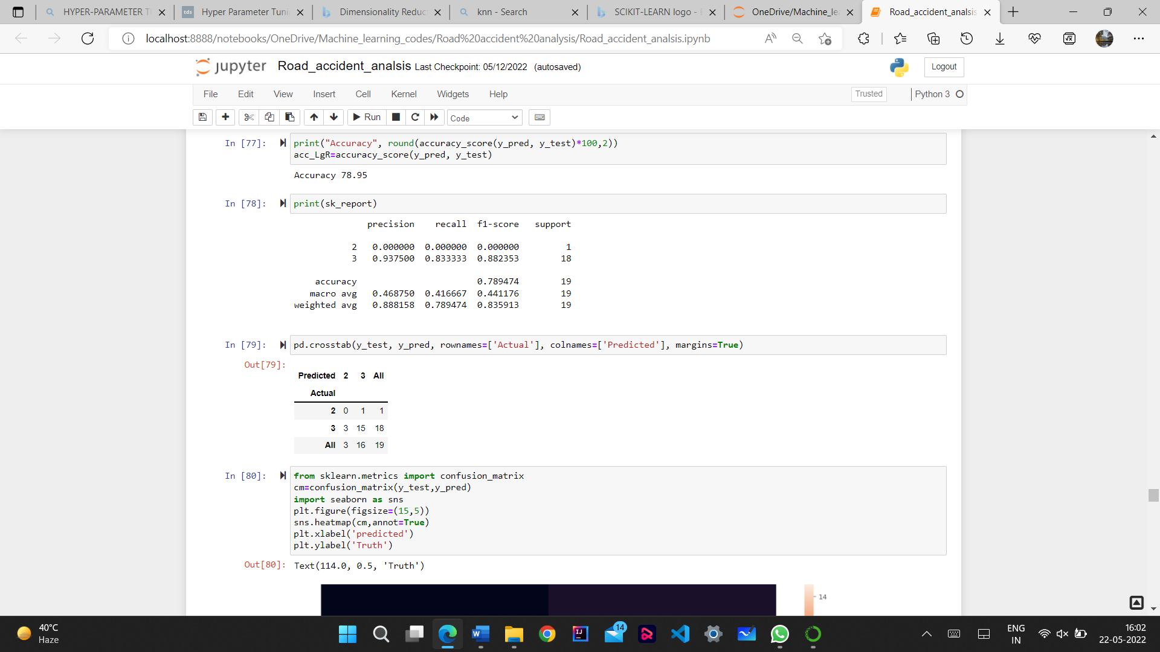
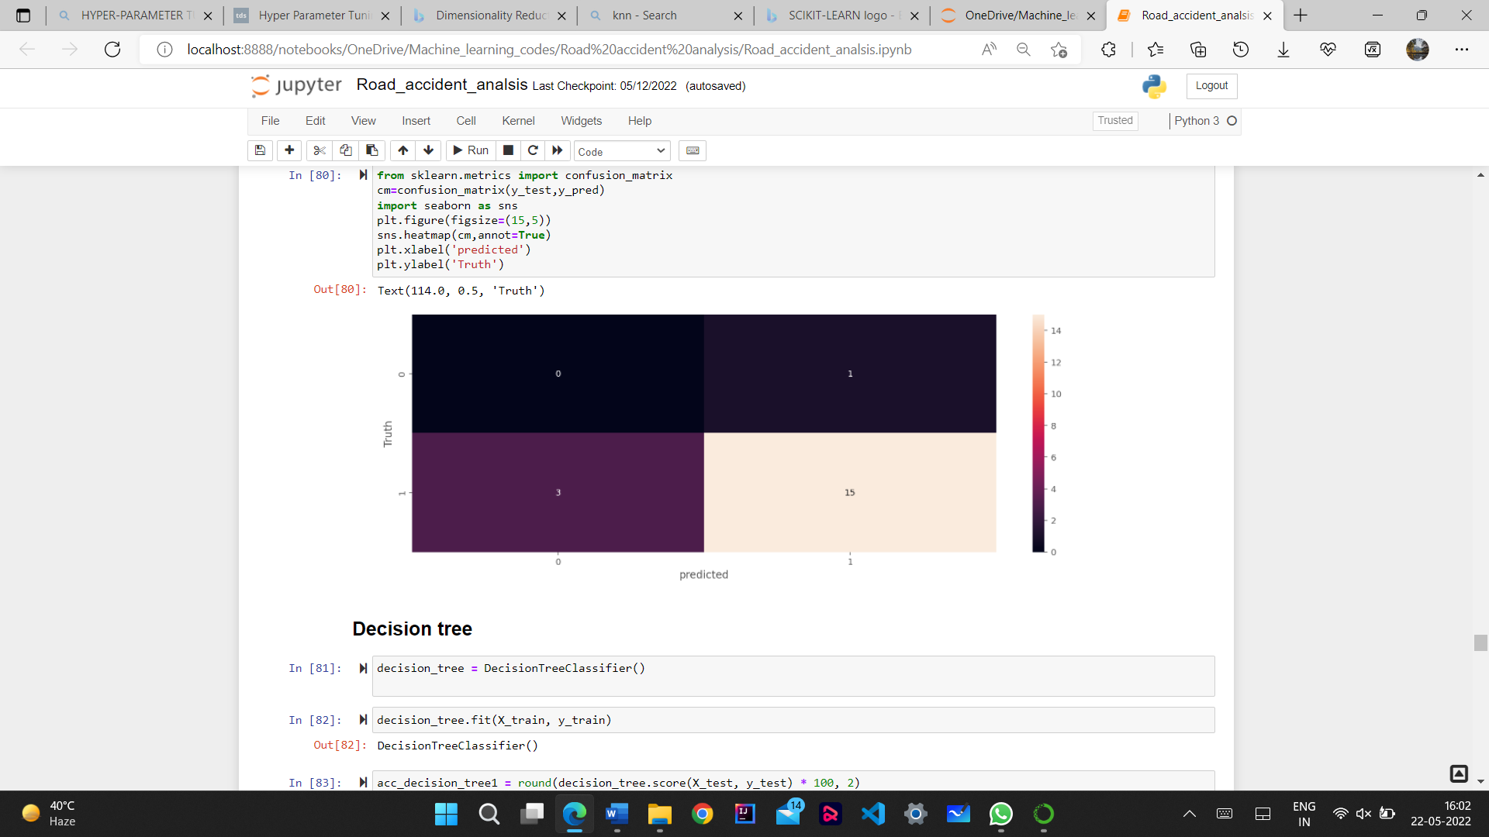
RESULTS AND OUTPUTS
LOGISTIC REGRESSION

Slide 12
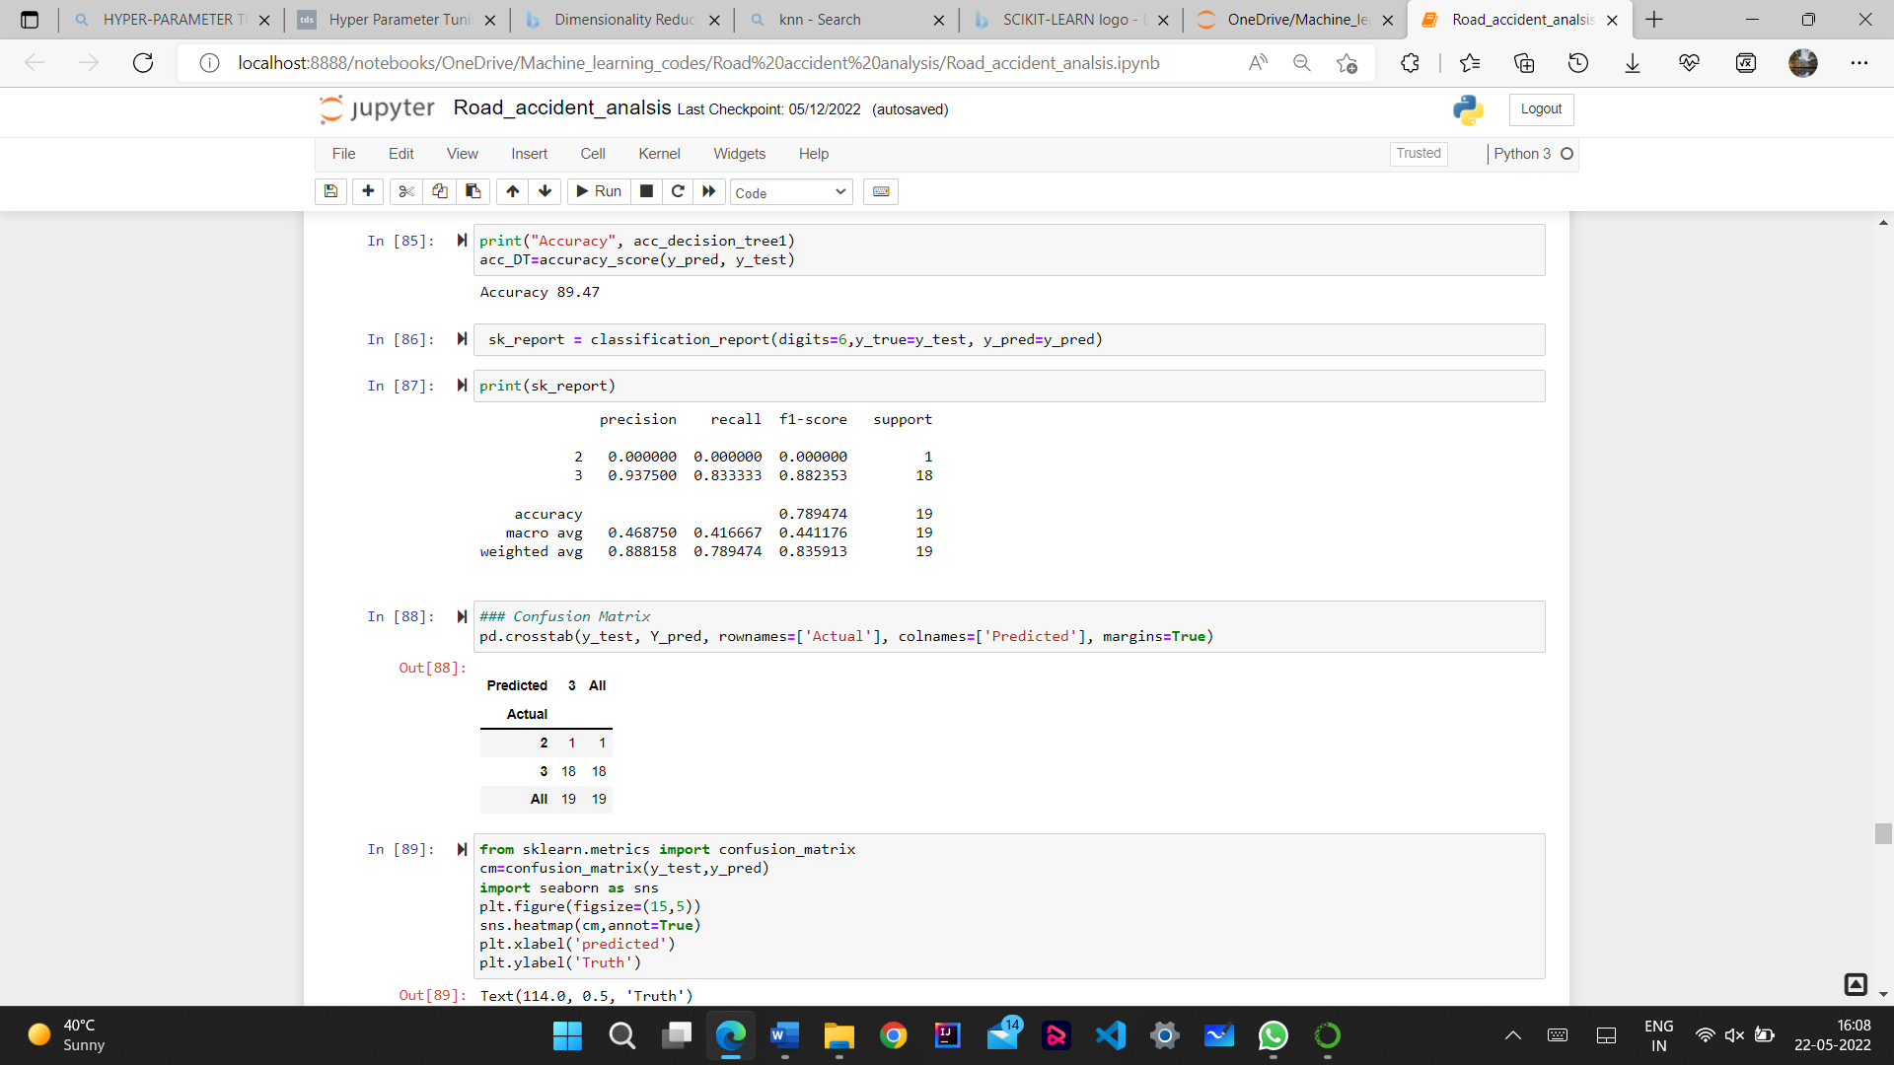
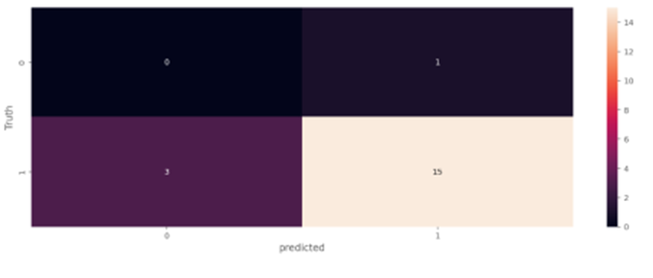
RESULTS AND OUTPUTS
DECISION TREE

Slide 13

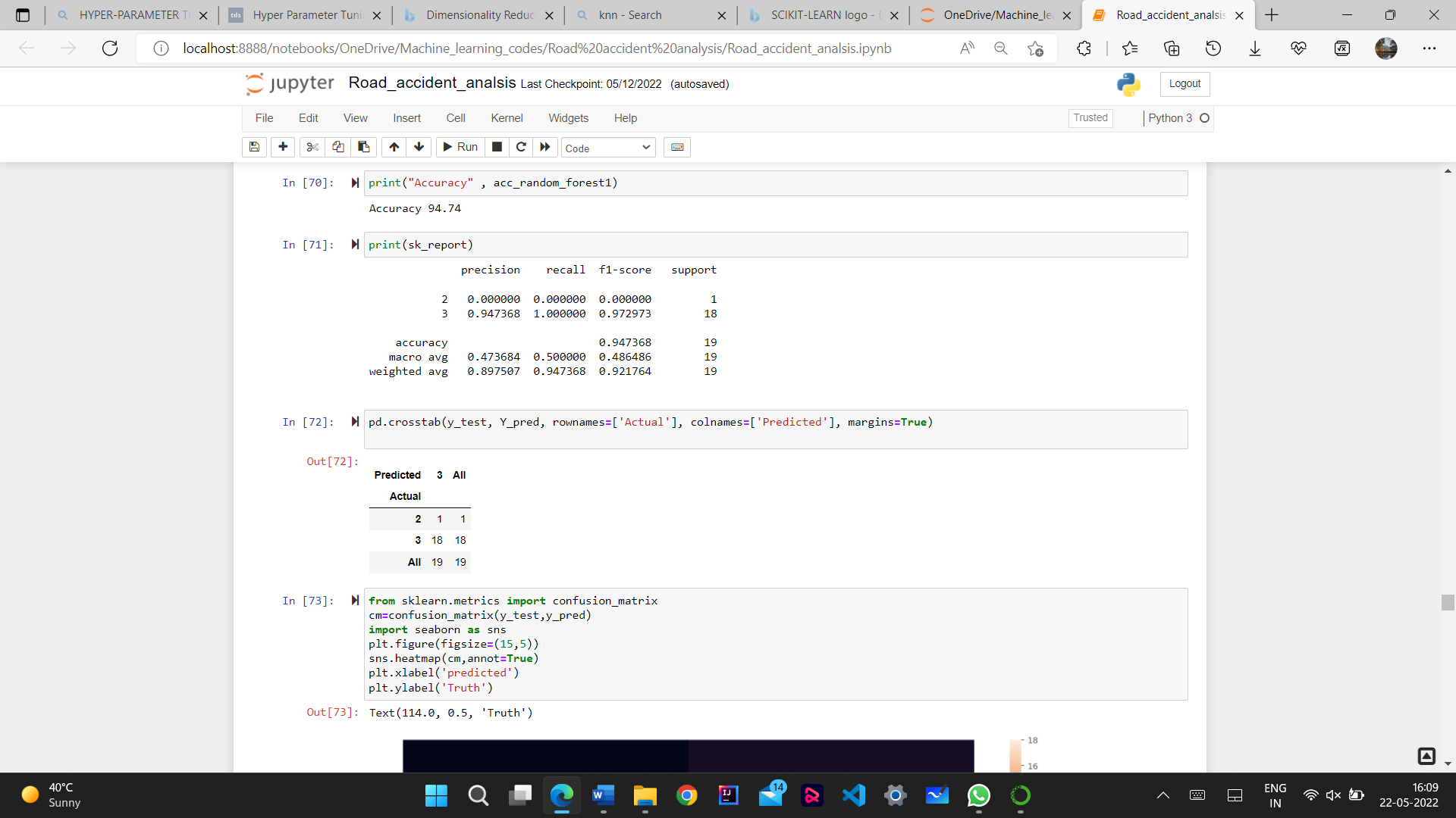
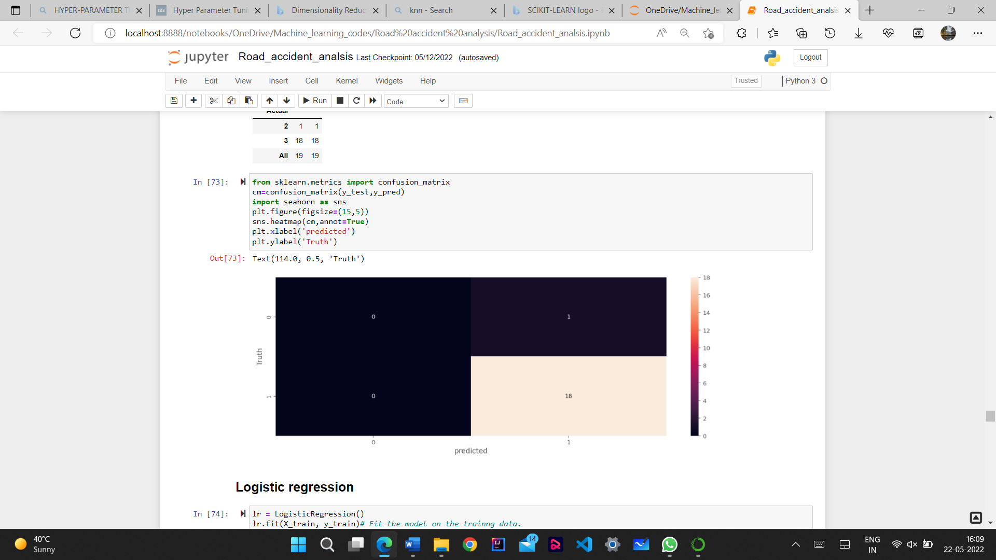
RESULTS AND OUTPUTS
RANDOM FOREST

Slide 14
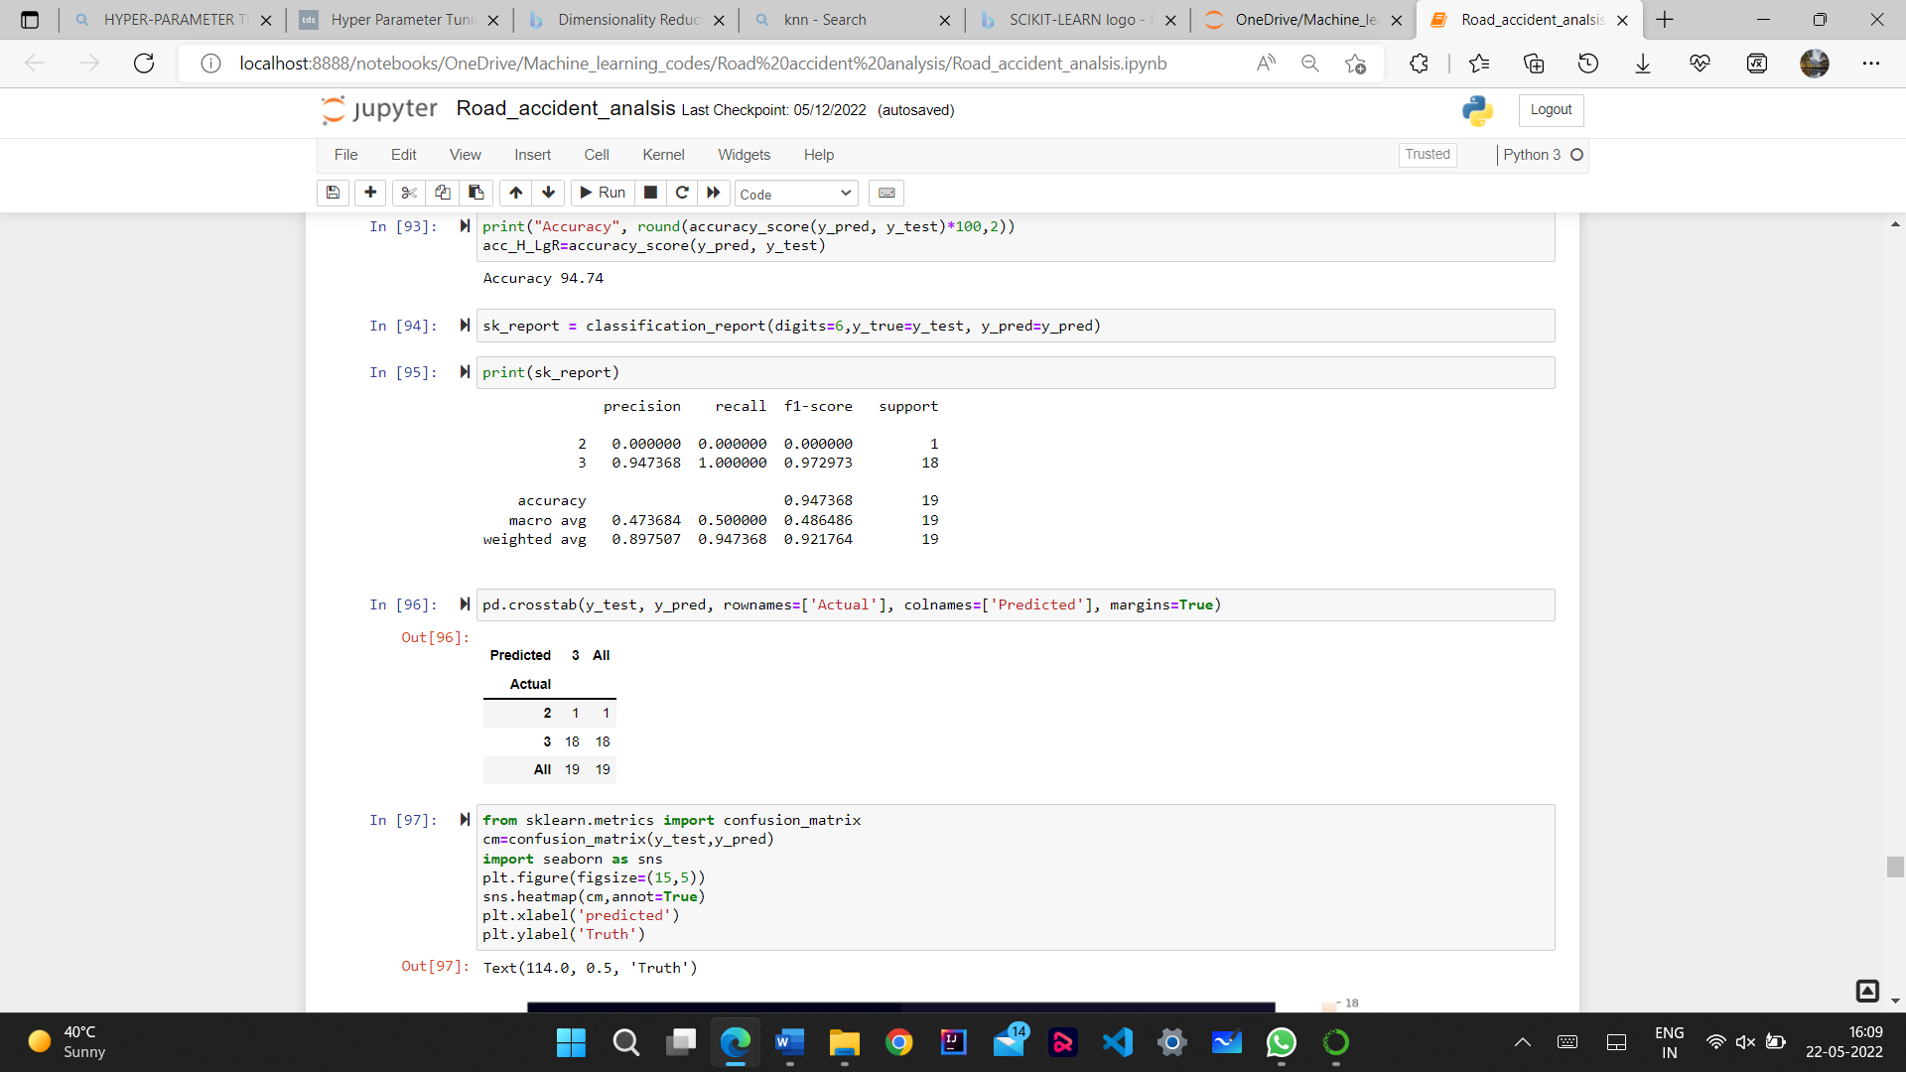
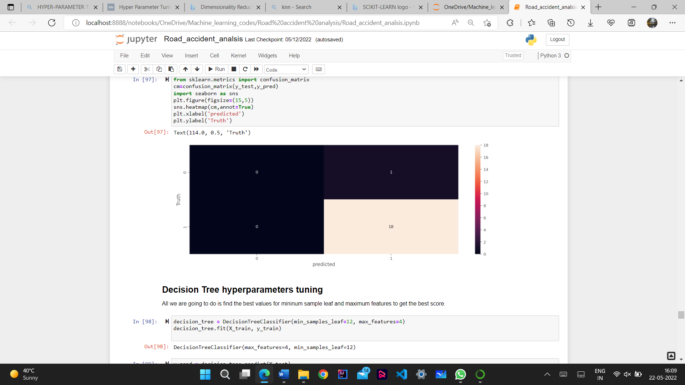
METHODOLOGY
HYPERPARAMETERS TUNING FOR LOGISTIC REGRESSION

Slide 15
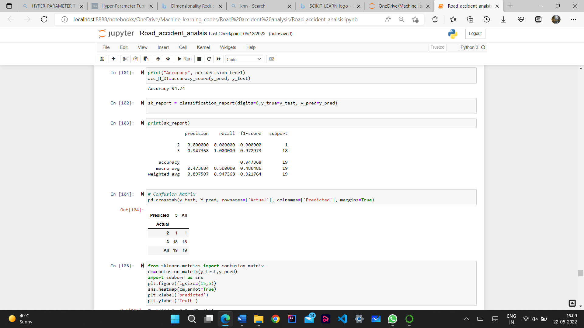
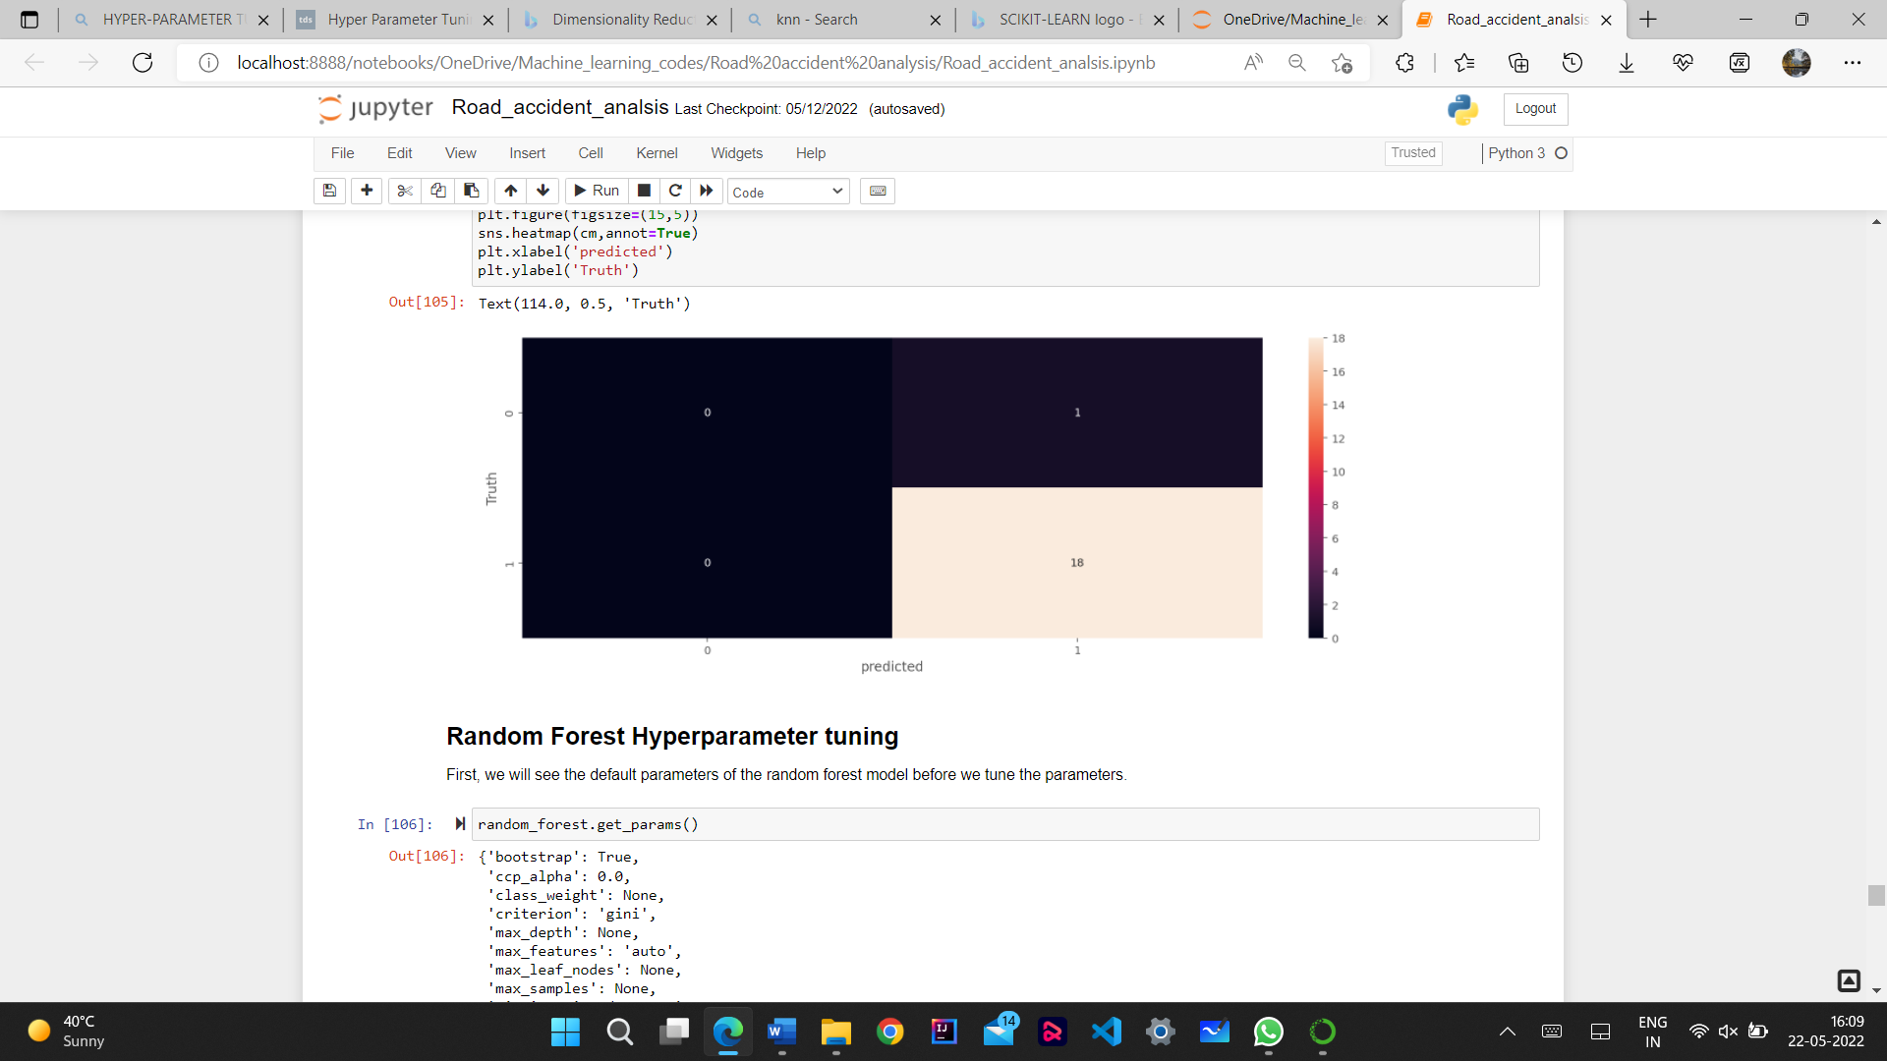
METHODOLOGY
HYPERPARAMETERS TUNING FOR DECISION TREE

Slide 16
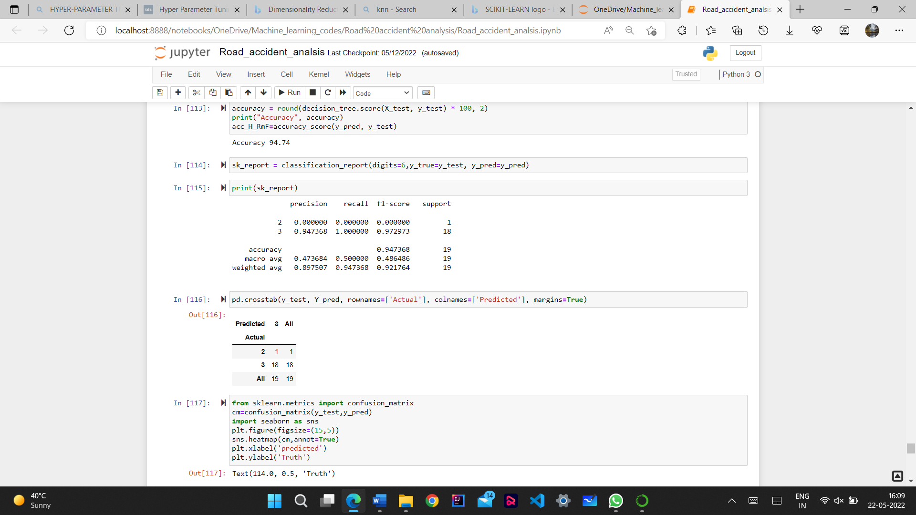
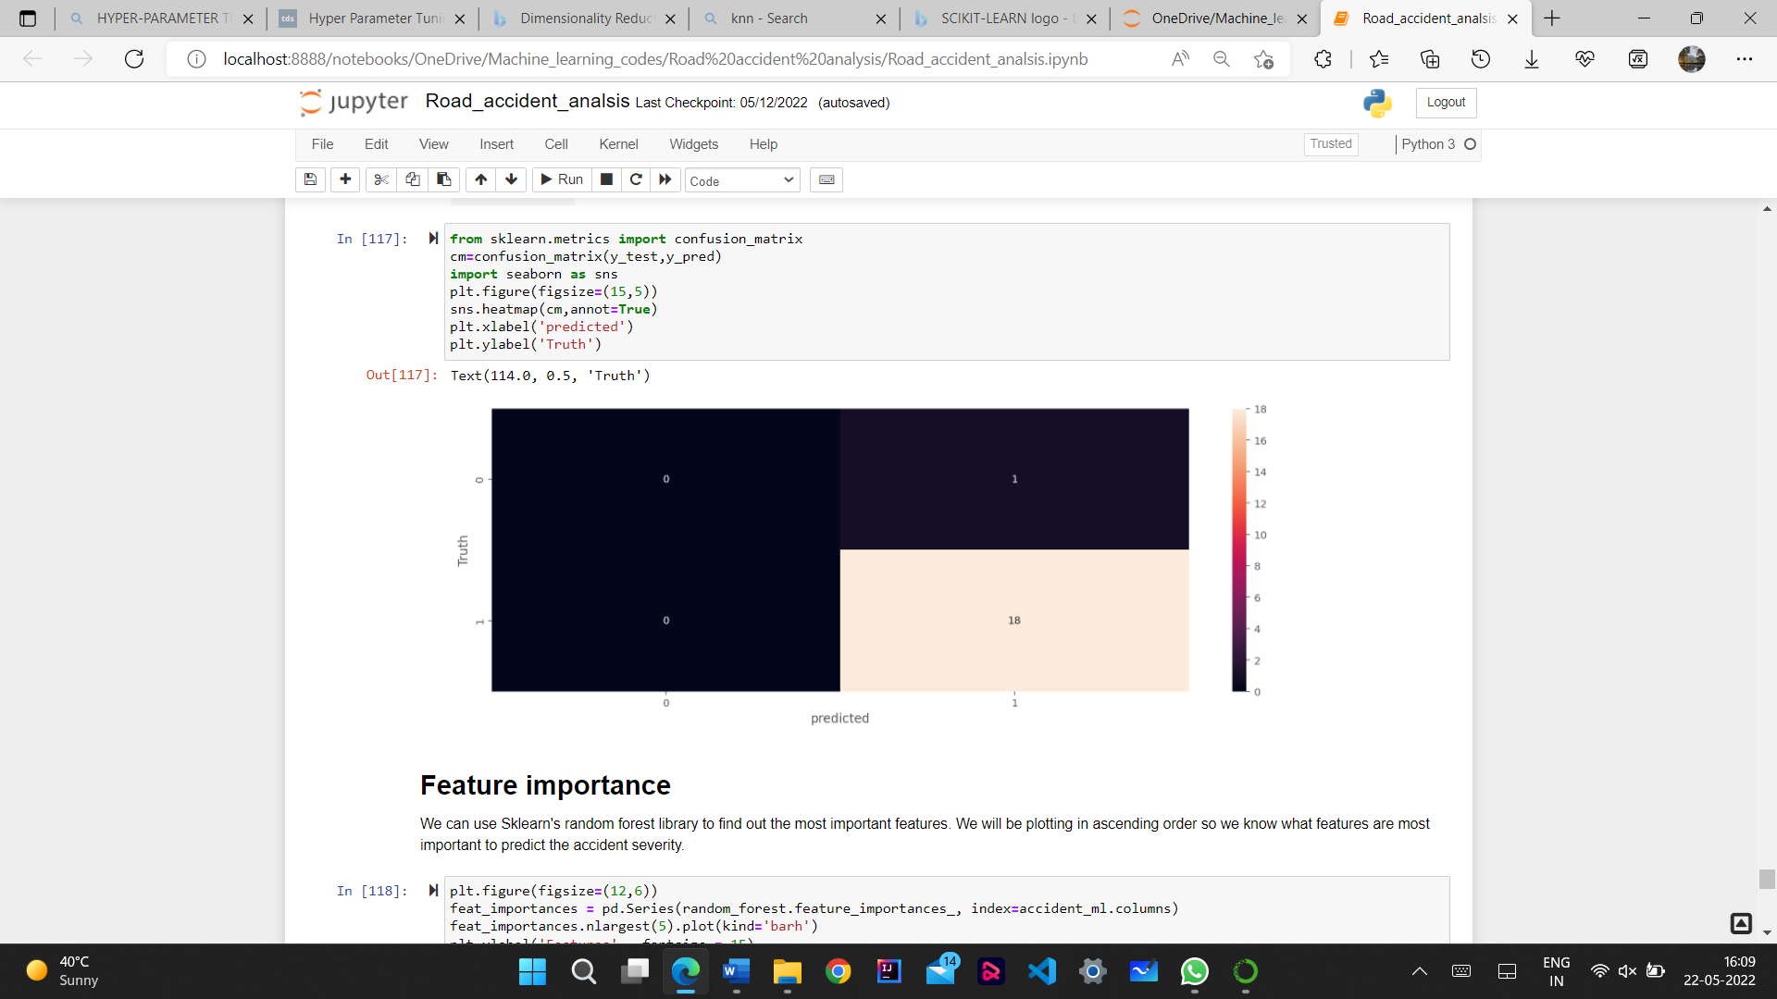
METHODOLOGY
HYPERPARAMETERS TUNING FOR RANDOM FOREST

Slide 17

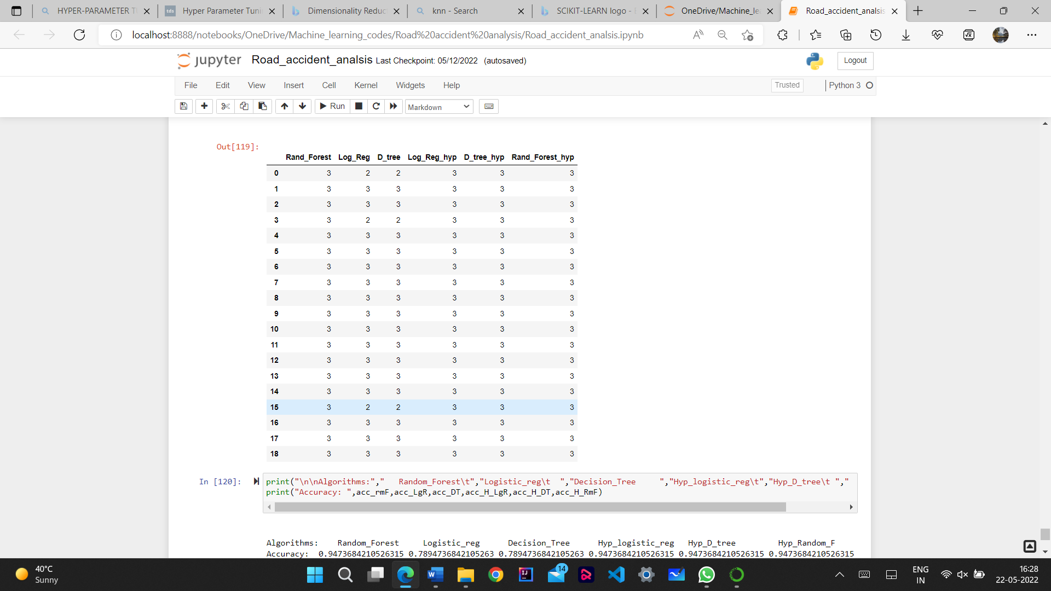
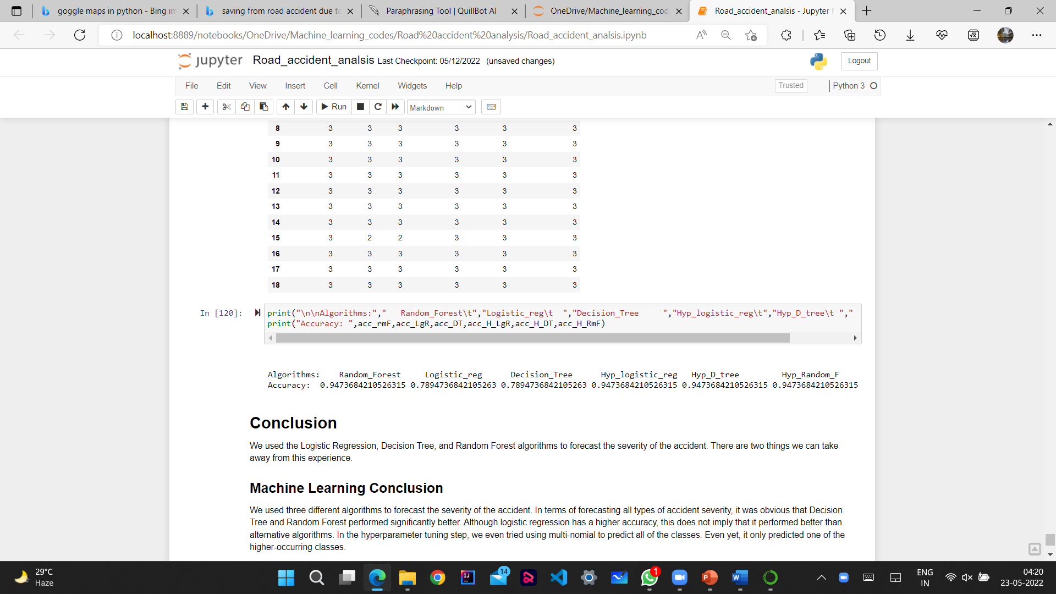
CONCLUSION
Hera the Accuracy of Random forest is more and the accuracy of decision tree and logistic regression is increased after doing Hyperparameter tuning.

Slide 18
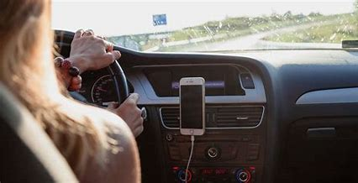
FUTURE SCOPE
This project will benefit everyone because it will allow people to predict the likelihood of an accident in the location from which they are traveling and at the time they are traveling.
So that people will be more cautious while driving, and many lives will be spared as a result of our project.
With increased resources, police can receive continuous predictions and alerts for each area at regular intervals to take preventive measures .
It will be more useful if you create a complete application.
By creating a full application it will be more helpful.
A fully-fledged web app for user and police interaction can be published for use in real-time. It can be used for Indian states or cities, if proper data of accidents is provided by the Indian Government.

Slide 19

REFERENCES
[1] Chong, M., Abraham, A., & Paprzycki, M. (2005). Traffic accident analysis using machine learning paradigms. Informatica, 29(1).
[2] Sridevi, N., M. V. Keerthana, Monisha V. Pal, T. R. Nikshitha, and P. Jyothi. "Road accident analysis using machine learning." International Journal of Research in Engineering, Science and Management 3, no. 5 (2020): 859-861.
[3] Labib, Md Farhan, et al. "Road accident analysis and prediction of accident severity by using machine learning in Bangladesh." 2019 7th International Conference on Smart Computing & Communications (ICSCC). IEEE, 2019.
[4] Nandurge, Priyanka A., and Nagaraj V. Dharwad. "Analyzing road accident data using machine learning paradigms." In 2017 International Conference on I-SMAC (IoT in Social, Mobile, Analytics and Cloud) (I-SMAC), pp. 604-610. IEEE, 2017.
[5] Karimnezhad, A. and Moradi, F., 2017. Road accident data analysis using Bayesian networks. Transportation letters, 9(1), pp.12-19.

